Slide 1
Diocesan Director
Briefing for 2014 Lenten Season
January 16, 2014

Slide 2
Agenda
Introductions/Agenda Review
Prayer
What is CRS Rice Bowl?
2013 Record Year
2014 Goal
2014: What’s and AWESOME?
Resources for Parishes, Educators, and More
Key Dates
Resources and Best Practices for Dioceses
Questions/Discussion

Slide 3
Prayer
Prayer for Educators of Justice and Peace
Good and gracious God, Teacher of all peoples,
Bless and guide those of us who seek to educate others about your good news of justice and peace.
Guide us in our work as we reach out to shape hearts and minds.
Walk with us as we deal with complex issues, help us to find the right words and actions to communicate your love for all members of the global family.
Questions and Discussion

Slide 4
Prayer
Support us as we promote critical reflections on local, national, and international issues. Renew our commitment, so we can spark courage and empower others to confront injustice.
Allow our vision of a better world to transform spirits. Help us to nurture the skills that will bring this vision to reality.
Remind us how blessed we are to have this call to proclaim justice and peace and to be able to respond even in small ways.
Give us patience and perseverance in our work. Grace us with fellowship and community. Help us to remember that you are our rest and refreshment.
Amen.
-by Jane Deren, from Living God’s Justice: Blessings and Prayers, 2006

Slide 5
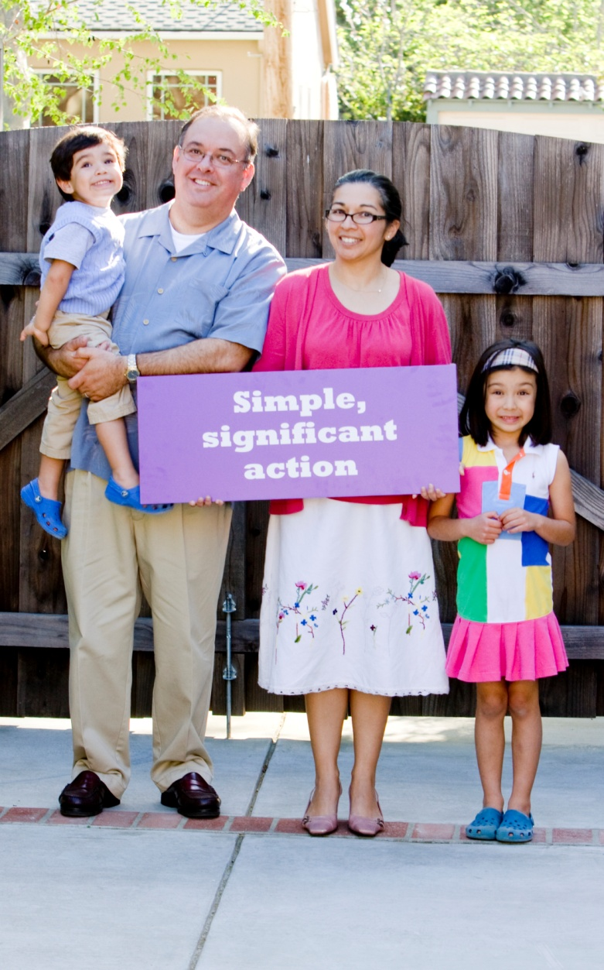
What is CRS Rice Bowl?
CRS’ Lenten faith-in-action program: prayer, fasting, giving
Families, parishes, schools, etc.
Connects Catholics in the United States with our brothers and sisters around the world
Brings Lent to life for faith communities and families in the home
Photo by Philip Laubner/CRS

Slide 6
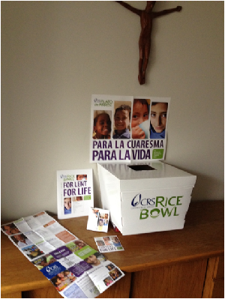
Record Year: 2013 Results
13,405 parishes and schools participating
60,347 website visitors = up 35% over 2012
Online donations up 200% over 2012
1,091,057 impressions generated from 10 influential Catholic bloggers and CRS Rice Bowl’s Twitter and Facebook content
Millions of Catholic families expressed their faith through prayer and sacrifice to help those in need

Slide 7
Record Year: 2013 Results
$10 million total collection
$7.5 million to CRS programs
$2.5 million for local diocesan programs
Highest annual revenue in program history
THANK YOU! Your hard work made this a success!
Notes:
For first time this year CRS sent checks back to the dioceses for 25% of donations we received outside of normal diocesan collection process

Slide 8
3 Year Goal
Strengthen faith formation value of program
Double engagement by 2015
Measured by:
Increased usage of website, videos, materials
Revenue generated through almsgiving
2014 = 2nd year of growth campaign

Slide 9
Faith in Action for Families
The Lenten Prayer
PRAY together as a family
“I Promise…”
Commit to FAST to help those around the world
Symbolic Gift Amounts
Find out what your ALMSGIVING is doing for the world’s poorest

Slide 10
Resources for Families
As you journey through the weeks of Lent…
Learn about the 2014 Featured Countries
Reflect on the importance of Catholic social teaching principles
Encounter Christ through the Stations of the Cross
Read passages from Scripture
Prepare a Simple Meal with your family on Fridays
Hear Thoughts from Pope Francis
Give to your Rice Bowl through fun and engaging activities

Slide 11
Resources for Families

Slide 12
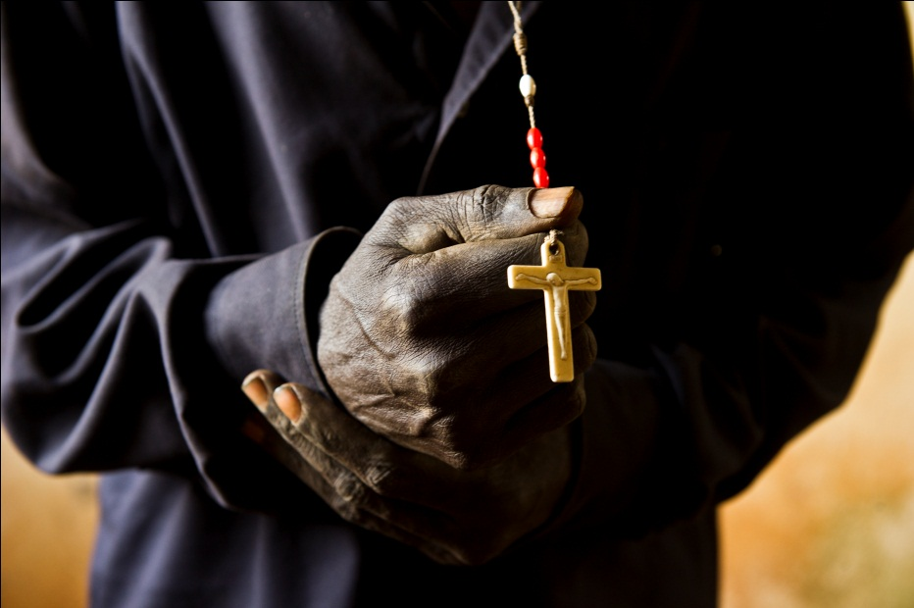
Countries Featured in 2014
Kenya
Developing Employment Opportunities
Sacredness and Dignity of the Human Person
Guatemala
Childhood Education
Rights and Responsibilities
Philippines
Emergency Response and Rebuilding
Option for the Poor
Malawi
Agricultural Development
Dignity of Work and Rights of Workers
Haiti
Mother and Child Healthcare
Social Nature of Humanity
Santa Fe, NM
Local 25 percent
Global Solidarity
Notes:
Here’s full list of countries featured in Spiritual Guide

Slide 13
A Catholic, Lenten App
CRS Rice Bowl mobile app (available for iPhone and Android)
Daily reflections sent directly to your phone
Track your Lenten sacrifices and fill up your “Virtual Rice Bowl”
Find meatless recipes and Stories of Hope
Free download available Febuary 5, 2014 in Apple store and Google Play Store

Slide 14
CRS Rice Bowl App
Daily Reflections delivered to your phone

Slide 15
CRS Rice Bowl App
Make a Lenten Goal and track your sacrifices

Slide 16
CRS Rice Bowl App
Find Meatless Recipes, Videos, and Stories of Hope

Slide 17
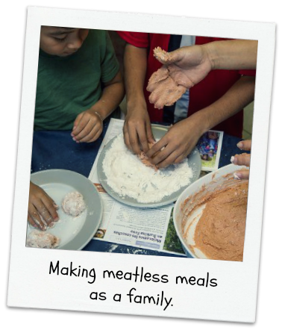
Lenten Photo Challenge
How do you do Rice Bowl?
Snap a photo of what you are doing for Lent …and WIN!
It begins Ash Wednesday,
March 5, 2014
Want more info?
Like us on Facebook. Follow us on Twitter. And stay tuned.

Slide 18
CRS Rice Bowl’s Global Kitchen
“CRS Rice Bowl’s Global Kitchen”
5 cooking shows featuring Fr. Leo Patalinghug from Grace Before Meals: available online Feb. 2014
3-minute videos highlight each of the meatless recipes
Printable and sharable recipe cards available at crsricebowl.org

Slide 19
Community Reflections
Guided meditations for small faith-sharing groups
Perfect for:
University Students
College Campus Ministry, Resident Assistants in Dorms
Young Adult Ministry
crsricebowl.org/university

Slide 20
Hispanic Ministry
Culturally relevant resources and devotions foster faith sharing for Hispanic families and communities
Spanish language Rice Bowl and Calendar for families in the home
Stations of the Cross
Los Siete Dolores de Maria
Reflections on the Lives of the Saints
crsplatodearroz.org

Slide 21
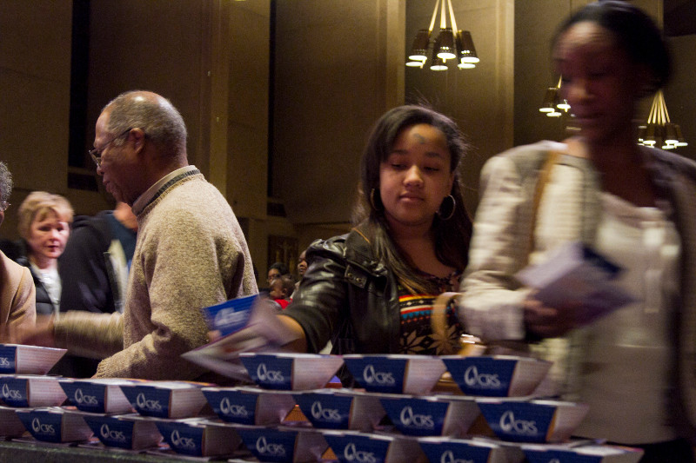
Faith Formation in Parishes
Coordinator’s Guide
Blessing of Rice Bowls
Prayer Intentions
Homily Notes
Stations of the Cross
End of Lent Offertory Procession
Engaging Parish Ministries
Small Faith-Sharing Groups
Youth Ministry & Relig Ed
Whole Community Catechesis
Available in (English and Spanish)
Online at crsricebowl.org/parish

Slide 22
Faith Formation for Educators
Educators’ Guide
Blessing of RBs Prayer Service
Letter to families
Lesson Plans Grades 1-12
Activity Worksheets
End of Lent Prayer Service
“Catholicism & the World” Quiz
Catholic Identity: Examples from the Saints
Etc.
Available in English or Spanish
Online: crsricebowl.org/schools

Slide 23
Additional Materials
Poster (English or Spanish)
Display (Bi-lingual)
DVD (Bi-lingual)
Videos from Kenya, Guatemala, Philippines, Malawi, Haiti
Video testimonial of family using CRS Rice Bowl for faith formation in the home (Spanish, w/English subtitles)

Slide 24
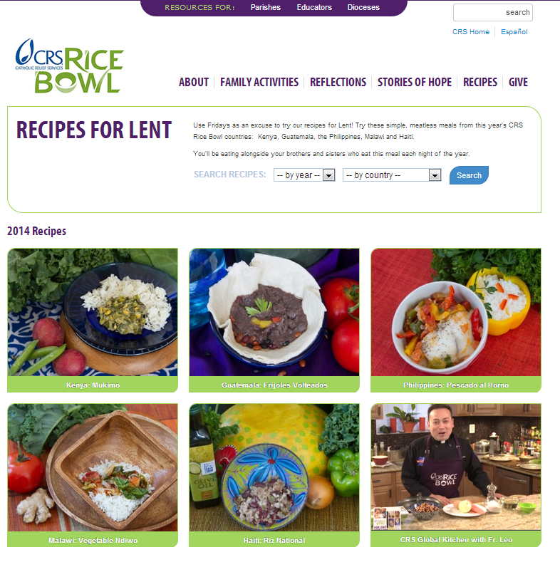
crsricebowl.org
Rice Bowl website
Simplified, easier to navigate
Family Activities, Reflections, Recipes, Stories of Hope
Coordinators’ Pages
Parishes
Blessing of Rice Bowls, Engaging Parish Ministries, Lenten Devotions, Collection tips
Educators
Communicate with families, Lesson Plans, Classroom Activities
crsplatodearroz.org
Spanish language resources

Slide 25
How to Get Materials
Materials available in English and Spanish
Materials free of charge
Order at 1-800-222-0025 or crsricebowl.org
Download at crsricebowl.org and crsplatodearroz.org

Slide 26
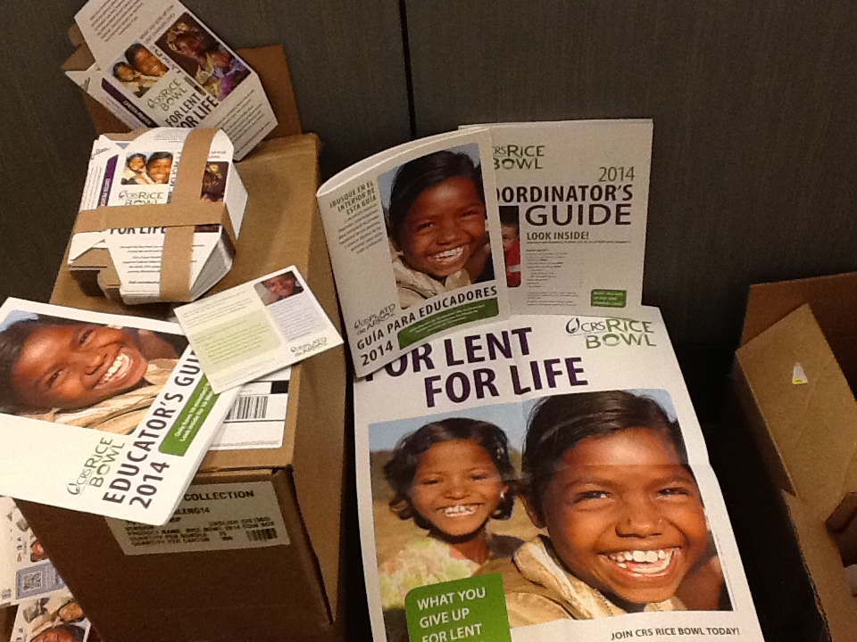
Lent 2014: Important Dates
January 8 → CRS Rice Bowl materials shipped (still time to order more materials!)
February 5 →Mobile App available in Apple and Google Play stores
March 5 → Ash Wednesday (photo challenge begins)
April 20 → Easter Sunday

Slide 27
Resources for Dioceses
Dioceses Web Page
Presentations
Resources for planning, promotion, collection, and thank you
crsricebowl.org/dioceses
Media Kit
Press Releases, Radio spots, photos, Videos, etc.
crsricebowl.org/about/mediakit

Slide 28
Diocesan Best Practices
Send Bishop Endorsement Letter to parishes and schools
Place an advertisement in your diocesan paper
Highlight local 25% projects
Connect with Diocesan Communications Office
Media Kit available on crsricebowl.org

Slide 29
Diocesan Best Practices
Spread the Word
Follow up on Facebook and Twitter and encourage others to as well
Share our posts, watch for updates on app, photo challenge, etc.
Put Banner ad on diocesan website
Offer Speakers to thank and inspire participants
Global Fellows, Overseas Trip Participants, CRS Fair Trade Ambassadors, CRS Speakers Tours
Call your regional office for ideas and assistance in placing speakers
Offer CRS Rice Bowl to Hispanic communities
Family faith-centered activities; Lenten themes connecting personal sacrifices with Jesus’ sacrifice on the cross resonate well
Encourage parishes to appoint a CRS Coordinator to organize Rice Bowl in the parish

Slide 30
Questions and Discussion
Type your best practices or questions into the chat box

